Slide 1
Krakow, Summer 2011
Planarity for Partially
Ordered Sets
William T. Trotter
trotter@math.gatech.edu

Slide 2
Planarity for Graphs – Well Understood
Theorem (Kuratowski) A graph G is planar if and only if it does not contain a homeomorph of K₅ or K_{3,3}.
Theorem Given a graph G, the question “Is G planar?” can be answered with an algorithm whose running time is linear in the number of vertices in G.

Slide 3
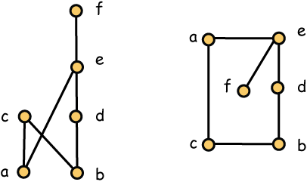
Diagrams and Cover Graphs
Order Diagram Cover Graph

Slide 4
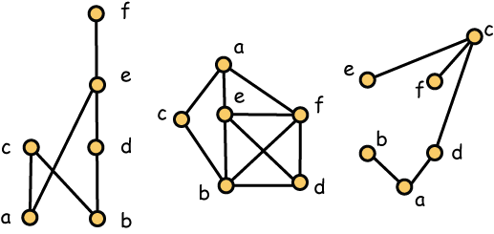
Comparability and Incomparability Graphs
Poset Comparability Graph Incomparability Graph

Slide 5
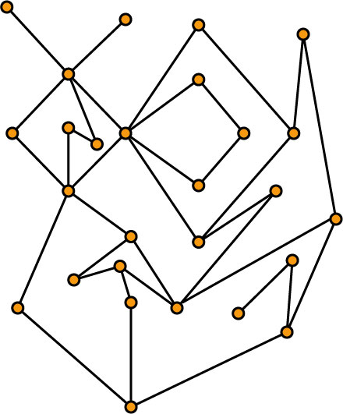
Planar Posets
Definition A poset P is planar when it has an order diagram with no edge crossings.
Exercise If P is planar, then it has an order diagram with straight line edges and no crossings.

Slide 6
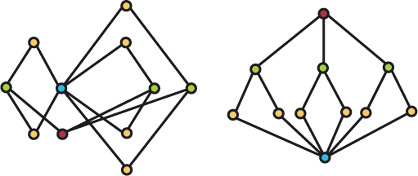
A Non-planar Poset
This height 3 non-planar poset has a planar cover graph.

Slide 7
Complexity Issues
Theorem (Garg and Tamassia) The question “Does P have a planar order diagram?” is NP-complete.
Theorem (Brightwell) The question “Is G a cover graph?” is NP-complete.

Slide 8
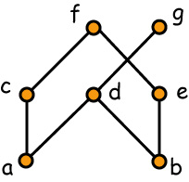
Realizers of Posets
A family F = {L₁, L₂, …, L_{t}} of linear extensions of P is a realizer of P if P = ∩ F, i.e., whenever x is incomparable to y in P, there is some L_{i} in F with x > y in L_{i}.
L₁ = b < e < a < d < g < c < f
L₂ = a < c < b < d < g < e < f
L₃ = a < c < b < e < f < d < g
L₄ = b < e < a < c < f < d < g
L₅ = a < b < d < g < e < c < f

Slide 9
The Dimension of a Poset
L₁ = b < e < a < d < g < c < f
L₂ = a < c < b < d < g < e < f
L₃ = a < c < b < e < f < d < g
The dimension of a poset is the minimum size of a realizer. This realizer shows dim(P) ≤ 3. In fact,
dim(P) = 3

Slide 10
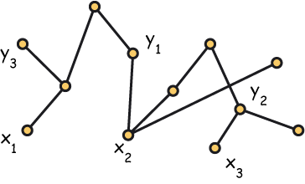
Dimension is Coloring for Ordered Pairs
Restatement Computing the dimension of a poset is equivalent to finding the chromatic number of a hypergraph whose vertices are the set of all ordered pairs (x, y) where x and y are incomparable in P. In this poset, no linear extension can put x_{i} over y_{i} for all i = 1, 2, 3.

Slide 11
Basic Properties of Dimension
Dimension is monotonic, i.e., if P is contained in Q, then dim(P) ≤ dim(Q).
Dimension is “continuous”, i.e., the removal of a point can lower the dimension by at most 1.
Dimension is at most the width.
Dimension is at most n/2 when P has n points and n is at least 4.

Slide 12
Testing dim(P) ≤ 2
Fact A poset P satisfies dim(P) ≤ 2 if and only if its incomparability graph is a comparability graph.
Fact Testing a graph on n vertices to determine whether it is a comparability graph can be done in O(n⁴) time.

Slide 13
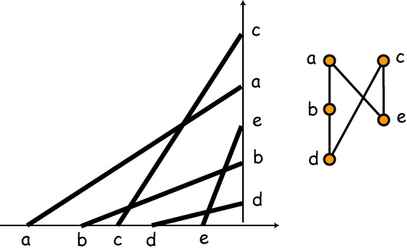
Posets of Dimension at most 2
Fact A poset P has such a representation if and only if it has dimension at most 2.

Slide 14
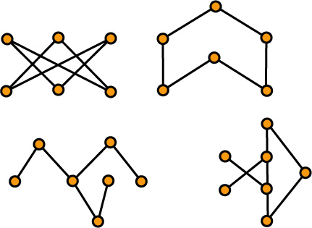
3-Irreducible Posets
Fact These posets are irreducible and have dimension 3. The full list of all such posets is known. It consists (up to duality) of 7 infinite families and 10 miscellaneous examples.

Slide 15
Complexity Issues for Dimension
Theorem (Yannakakis) For fixed t ≥ 3, the question dim(P) ≤ t ? is NP-complete.
Theorem (Yannakakis) For fixed t ≥ 4, the question dim(P) ≤ t ? is NP-complete, even when P has height 2.

Slide 16
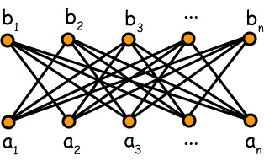
Standard Examples
S_{n}
Fact For n ≥ 2, the standard example S_{n} is a poset of dimension n.
Note If L is a linear extension of S_{n}, there can only be one value of i for which a_{i} > b_{i} in L.

Slide 17
Meta Question
What are the combinatorial connections between graph planarity, poset planarity and parameters like height and dimension?

Slide 18
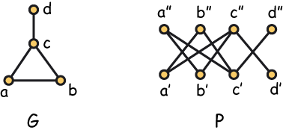
Adjacency Posets
The adjacency poset P of a graph G = (V, E) is a height 2 poset with minimal elements {x’: x ∈ V}, maximal elements {x’’: x ∈ V}, and ordering: x’ < y’’ if and only if xy ∈ E.

Slide 19
Adjacency Posets and Dimension
Fact The standard example S_{n} is just the adjacency poset of the complete graph K_{n}.
Fact If P is the adjacency poset of a graph G, then dim(P) ≥ χ(G).
To see this, let F = {L₁, L₂, …, L_{t}} be a realizer of P. For each vertex x in P, choose an integer i with x’ over x” in L_{i}. This rule determines a t-coloring of G.

Slide 20
Dimension and Small Height
Theorem (Erdős, ‘59) For every g, t, there exists a graph G with χ(G) > t and girth of G at least g.
Observation If we take the adacency poset of such a graph, we get a poset P of height 2 for which dim(P) > t and the girth of the comparability graph of P is at least g.

Slide 21
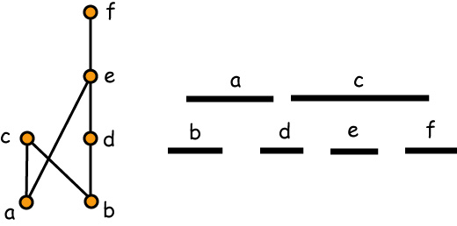
Interval Orders
A poset P is an interval order if there exists a function I assigning to each x in P a closed interval I(x) = [a_{x}, b_{x}] of the real line R so that x < y in P if and only if b_{x} < a_{y} in R.

Slide 22
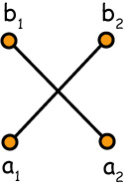
Characterizing Interval Orders
Theorem (Fishburn, ‘70) A poset is an interval order if and only if it does not contain the standard example S₂.
S₂ = 2 + 2

Slide 23
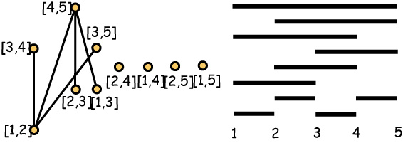
Canonical Interval Orders
The canonical interval order I_{n} consists of all intervals with integer end points from {1, 2, …, n}.
I₅

Slide 24
Dimension of Interval Orders
Theorem (Füredi, Rödl, Hajnal and WTT, ‘91) The dimension of the canonical interval order I_{n} is
lg lg n + (1/2 - o(1)) lg lg lg n
Corollary The dimension of an interval order of height h is at most
lg lg h + (1/2 - o(1)) lg lg lg h

Slide 25
Sometime Large Height is Necessary
Observation Posets of height 2 can have arbitrarily large dimension … but among the interval orders, large dimension requires large height.

Slide 26
The Bound is Not Tight
Fact If P is the adjacency poset of a graph G, then dim(P) ≥ χ(G).
Fact If G is the subdivision of K_{n}, then χ(G) = 2 but the dimension of the adjacency poset of G is
lg lg n + (1/2 - o(1)) lg lg lg n

Slide 27
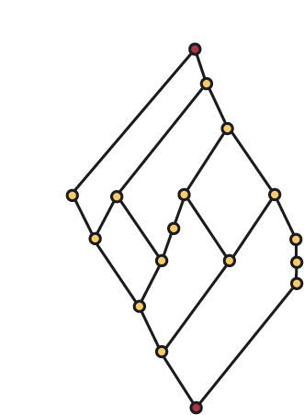
Planar Posets with Zero and One
Theorem (Baker, Fishburn and Roberts ‘71 + Folklore)
If P has both a 0 and a 1, then P is planar if and only if it is a lattice and has dimension at most 2.
Exercise Prove this theorem.

Slide 28
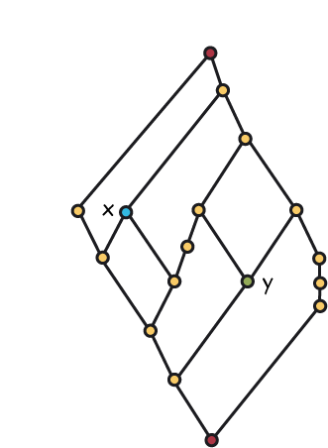
The Heart of the Proof
Observation
If x and y are incomparable, one is left of the other. Left is transitive.

Slide 29
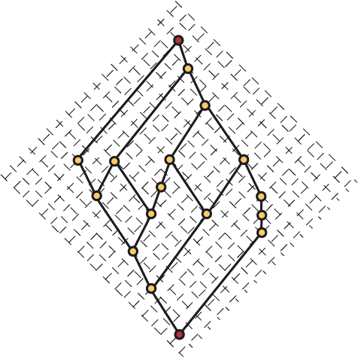
Explicit Embedding on the Integer Grid

Slide 30
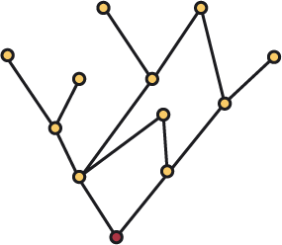
Dimension of Planar Poset with a Zero
Theorem (WTT and Moore, ‘77) If P has a 0 and the diagram of P is planar, then dim(P) ≤ 3.

Slide 31
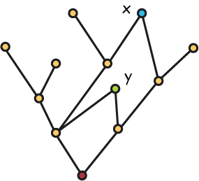
Modifying the Proof
Observation It may happen that x and y are incomparable and neither is left of the other. But in this case, one is over the other. Here x is over y.

Slide 32
The Dimension of a Tree
Corollary If the cover graph of P is a tree, then dim(P) ≤ 3.
Exercise Of course, the corollary follows by showing that the poset obtained by adding a zero to a tree is planar. Prove this.

Slide 33
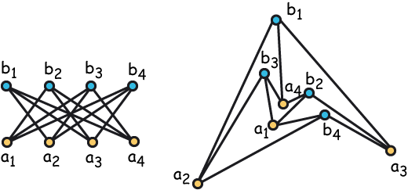
A 4-dimensional planar poset
Fact The standard example S₄ is planar!

Slide 34
Wishful Thinking: If Frogs Had Wings …
Question Could it possibly be true that dim(P) ≤ 4 for every planar poset P?
We observe that
dim(P) ≤ 2 when P has a zero and a one.
dim(P) ≤ 3 when P has a zero or a one.
So why not dim(P) ≤ 4 in the general case?

Slide 35
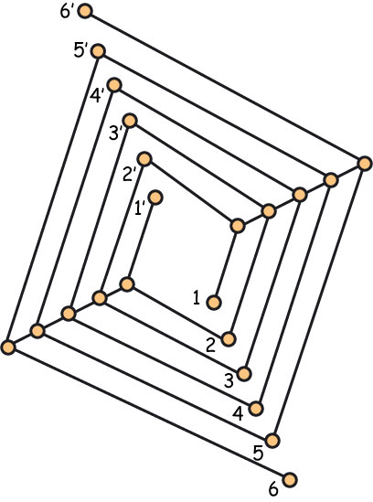
No … by Kelly’s Construction
Theorem (Kelly) For every n ≥ 5 , the standard example S_{n} is nonplanar but it is a subposet of a planar poset.

Slide 36
Eight Years of Silence
Kelly’s construction more or less killed the subject, at least for the time being.

Slide 37
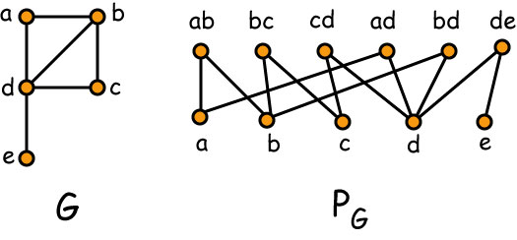
The Vertex-Edge Poset of a Graph

Slide 38
Some Elementary Observations
Fact 1 The dimension of the vertex-edge poset of K₅ is 4.
Fact 2 The dimension of the vertex-edge poset of K_{3,3} is 4.

Slide 39
Schnyder’s Theorem
Theorem (Schnyder) A graph is planar if and only if the dimension of its vertex-edge poset is at most 3.
Note Testing graph planarity is linear in the number of edges while testing for dimension at most 3 is NP-complete!!!

Slide 40
The Role of Homeomorphs
Confession I didn’t have the slightest idea what might be the dimension of the vertex-edge poset of a homeomorph of K₅ or K_{3,3}.
Timeline First contact with Schnyder was in 1986, maybe even 1985.

Slide 41
Structure and Schnyder
Schnyder’s proof is a classic, elegant and rich in structure.
His motivation was to find an efficient layout of a planar graph on a small grid.
Recently, Haxell and Barrera-Cruz have found a direct proof, sans the structure, but the value of Schnyder’s original approach remains intact.

Slide 42
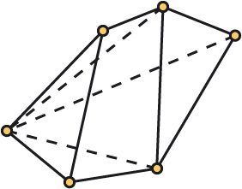
Convex Polytopes and Steinitz’s Theorem

Slide 43
3-Connected Planar Graphs
Theorem (Brightwell and WTT) If G is a planar 3-connected graph and P is the vertex-edge-face poset of G, then dim(P) = 4.
Furthermore, the removal of any vertex or any face from P reduces the dimension to 3.

Slide 44
Convex Polytopes
Theorem (Brightwell and WTT) If M is a convex polytope in R³, and P is the vertex-edge-face poset of M, then dim(P) = 4.
Furthermore, the removal of any vertex or any face from P reduces the dimension to 3.

Slide 45
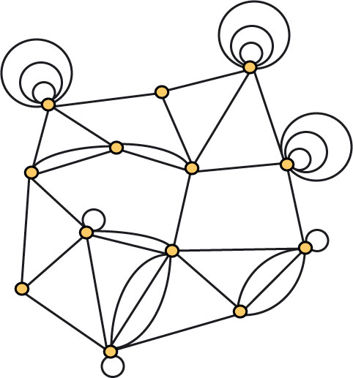
Planar Multigraphs

Slide 46
Planar Multigraphs and Dimension
Theorem (Brightwell and WTT): Let D be a non-crossing drawing of a planar multigraph G, and let P be the vertex-edge-face poset determined by D. Then dim(P) ≤ 4.
Different drawings may determine posets with different dimensions.

Slide 47
Characterizing Outerplanar Graphs
Theorem (Felsner and WTT) A graph is outerplanar if and only if the dimension of its vertex-edge poset is at most 5/2.

Slide 48
Adjacency Posets, Planarity and Genus
Fact If P is the adjacency poset of a graph G, then dim(P) ≥ χ(G) … and the inequality may be far from tight.
However, could it be true that the dimension of an adjacency poset is bounded in terms of the genus of the graph? In particular, does there exist a constant c so that dim(P) ≤ c whenever P is the adjacency poset of a planar graph?

Slide 49
Adjacency Posets of Planar Graphs
Theorem (Felsner, Li, WTT, ‘10) If P is the adjacency poset of a planar graph, then dim (P) ≤ 8.
Fact There exists a planar graph whose adjacency poset has dimension 5.

Slide 50
Outerplanar Graphs
Theorem (Felsner, Li, WTT) If P is the adjacency poset of an outerplanar graph, then dim (P) ≤ 5.
Fact There exists an outerplanar graph whose adjacency poset has dimension 4.

Slide 51
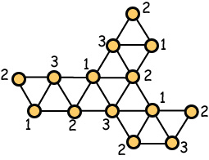
Outerplanar Graphs – Lower Bounds
Exercise The dimension of the adjacency poset of this outerplanar graph is 4.

Slide 52
Bipartite Planar Graphs
Theorem (Felsner, Li, WTT) If P is the adjacency poset of a bipartite planar graph, then dim (P) ≤ 4.
Corollary If P has height 2 and the cover graph of P is planar, then dim(P) ≤ 4.
Fact Both results are best possible.

Slide 53
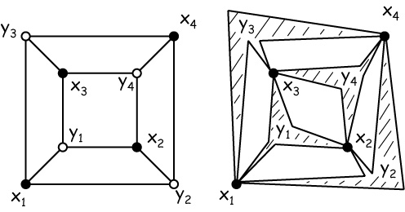
Maximal Elements as Faces

Slide 54
Adjacency Posets and Genus
Theorem (Felsner, Li, WTT) If the acyclic chromatic number of G is a, the dimension of the adjacency poset of G is at most 3a(a-1)/2.
Theorem (Alon, Mohar, Sanders) The acyclic chromatic number of a graph of genus g is O(g ^{4/7}).
Corollary For every g, there exists a constant c(g) so that if P is the adjacency poset of a graph of genus g, then dim (P) ≤ c(g).

Slide 55
Bipartite Planar Graphs
Theorem (Moore; Also Di Battista, Liu and Rival) If P is a poset of height 2 and the cover graph of P is planar, then P is planar, i.e., the order diagram of P is planar.
Note The result is best possible since there exist height 3 nonplanar posets that have planar cover graphs.

Slide 56
A Non-planar Poset
This height 3 non-planar poset has a planar cover graph.

Slide 57
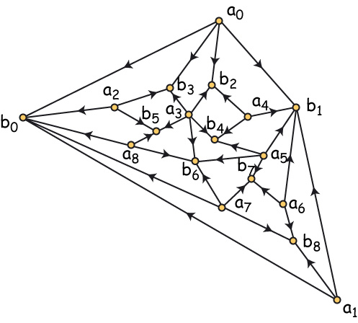
Diagrams of Bipartite Planar Graphs
Why should it be possible to draw the order diagram of this height 2 poset without edge crossings?

Slide 58
Planar Cover Graphs, Dimension and Height
Conjecture (Felsner and WTT) For every integer h, there exists a constant c_{h} so that if P is a poset of height h and the cover graph of P is planar, then dim(P) ≤ c_{h}.
Observation The conjecture holds trivially for h = 1 and c₁ = 2. Although very non-trivial, the conjecture also holds for h = 2, and c₂ = 4.
Fact Kelly’s construction shows that c_{h} - if it exists -must be at least h + 1.

Slide 59
Conjecture Resolved
Theorem (Streib and WTT) For every integer h, there exists a constant c_{h} so that if P is a poset of height h and the cover graph of P is planar, then dim(P) ≤ c_{h}.
Fact A straightforward modification to Kelly’s construction shows that c_{h} must be at least h + 2.
However, our proof uses Ramsey theory at several key places and the bound we obtain is very large in terms of h.

Slide 60
Kelly’s Construction
Fact For every h ≥ 4 , the standard example S_{h-1} is contained in a planar poset of height h.

Slide 61
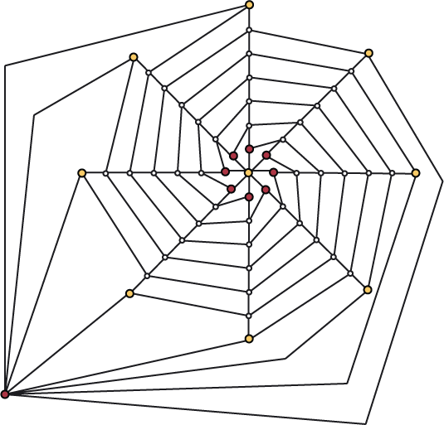
A Modest Improvement
Fact For every h ≥ 2 , the standard example S_{h+2} is contained in a poset of height h having a planar cover graph.

Slide 62
Some Open Questions
Which posets are subposets of planar posets?
For each t ≥ 4, what is the smallest planar poset having dimension t?
Improve the bounds for the dimension of the adjacency posets of planar and outerplanar graphs.
Improve the bounds for the constant c_{h} in the Streib-WTT theorem.

